Slide 1
MILESTONE 2 · INTERACTIVE ANALYTICS DASHBOARD
Smart Urban Mobility
Intelligence
A geospatial analytics dashboard for India's public transit network — mapping mobility patterns, route performance, and passenger demand across 16 major cities.
16
1,500
10+
CITIES TRACKED
RECORDS ANALYZED
LIVE VISUAL LAYERS
Built with Python · Pandas · Dash · Plotly

Slide 2
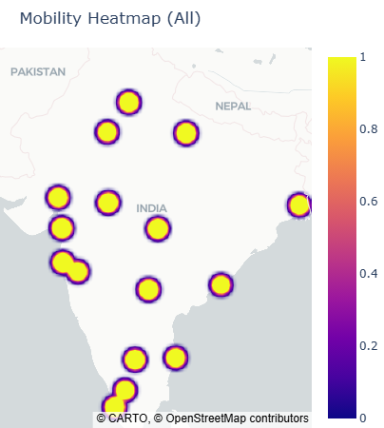
PROJECT OVERVIEW
Turning raw transit data into operational insight
1
Objective
Give city planners and transit operators a single, interactive view of how people move — where demand concentrates, which routes underperform, and how conditions vary city to city.
2
Scope
Covers 16 major Indian cities across 500+ geospatial records and 1,000 transit route records, spanning road, metro, bus, and mixed-mode transport.
3
Approach
Combine two structured datasets, clean and aggregate with Pandas, and expose the results through a live, filterable Dash + Plotly web dashboard.
Live mobility heatmap — all 16 tracked cities
SMART URBAN MOBILITY INTELLIGENCE
2

Slide 3
DATA FOUNDATION
Two structured datasets power the dashboard
India_Geospatial.csv
India_Transit_Dashboard.csv
500 records 19 fields
1000 records 23 fields
Covers 16 cities
Covers 16 cities
KEY FIELDS
KEY FIELDS
City, State, Area, Road Type
Latitude / Longitude
Traffic Speed, Road Occupancy %
Emission Level, Parking Availability
Passenger Demand, Weather Condition
Transit ID, Route ID, Source → Destination
Passenger Count, Vehicle Capacity
Travel Time, Delay, Fare (INR)
On-Time Status, Traffic Status
Path Order, Latitude / Longitude
SMART URBAN MOBILITY INTELLIGENCE
3

Slide 4
SYSTEM ARCHITECTURE
From raw CSVs to a live interactive dashboard
1
2
3
4
Ingest
Clean
Model
Serve
pandas
→
pandas
→
plotly express
→
dash
Load India_Geospatial.csv and India_Transit_Dashboard.csv; strip and standardize column names.
Coerce numeric fields — passenger count, speed, travel time, lat/long — and handle missing values.
Aggregate by route, city, and area to drive KPIs, rankings, and hierarchy views.
Render an interactive, filterable web app with live callbacks and CSV / HTML export.
Runtime: Python 3 · dash, plotly, pandas · deployed as a self-contained local web application (port 8050)
SMART URBAN MOBILITY INTELLIGENCE
SMART URBAN MOBILITY INTELLIGENCE
4
4

Slide 5
DASHBOARD CAPABILITIES
One dashboard, six ways to explore the network
1
City Filter
2
KPI Cards
3
Geospatial Maps
Switch instantly between all-India and any of 16 individual cities; every chart and KPI updates live.
Total passengers, average travel time, average speed, and on-time performance, recalculated per selection.
A mobility density heatmap and a route-by-route transit flow map plotted on real geography.
4
Route Analytics
5
Demand Hierarchy
6
One-Click Export
Top 10 routes ranked by passenger volume and by average speed, side by side.
Treemap and sunburst views drill from State → City → Source area by passenger count.
Download the current view as a standalone HTML dashboard or the filtered data as CSV.
SMART URBAN MOBILITY INTELLIGENCE
5

Slide 6
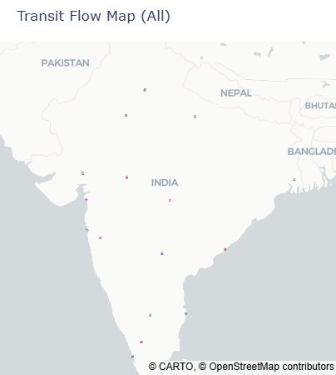
NATIONAL OVERVIEW
Where India's mobility demand concentrates
All-city view — every marker represents an aggregated location from the geospatial and transit datasets.
READING THE MAPS
Bright yellow clusters
mark peak mobility density.
Colored lines
trace individual transit routes between source and destination points.
Coverage spans
north, west, south and east India — from Delhi to Kochi.
Mobility Heatmap — demand intensity by city
Transit Flow Map — active routes, colored by Route ID
SMART URBAN MOBILITY INTELLIGENCE
6

Slide 7
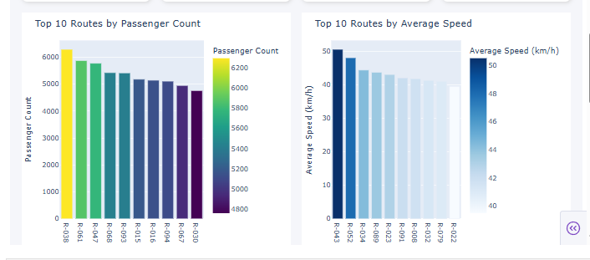
ROUTE PERFORMANCE · ALL INDIA
How the network performs, end to end
256,859
32.1 min
30.9 km/h
18.4%
TOTAL PASSENGERS
AVG. TRAVEL TIME
AVG. SPEED
ON-TIME PERFORMANCE
Top 10 routes by passenger count (left) and by average speed (right)
SMART URBAN MOBILITY INTELLIGENCE
7

Slide 8
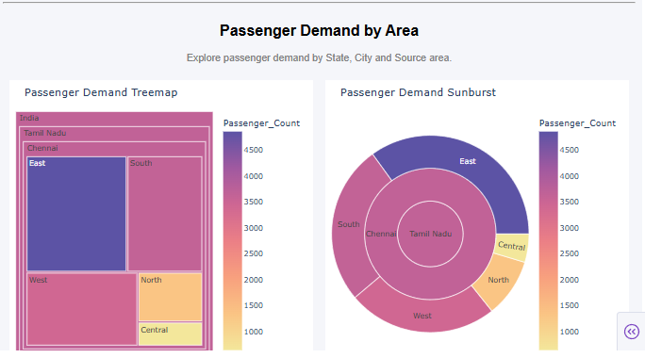
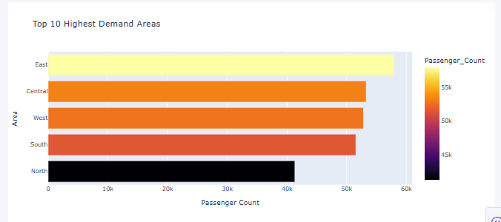
PASSENGER DEMAND · ALL INDIA
From state down to source area
India → State → City → Source, sized and colored by passenger volume.
Passenger demand treemap (left) and sunburst (right)
Top 10 highest-demand areas
SMART URBAN MOBILITY INTELLIGENCE
8

Slide 9
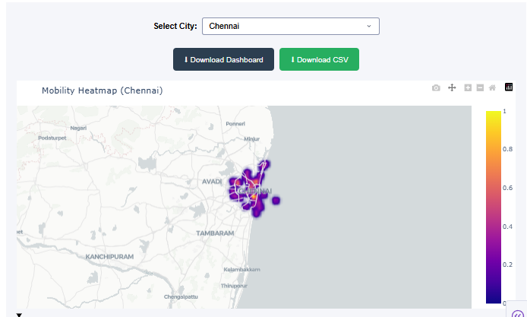
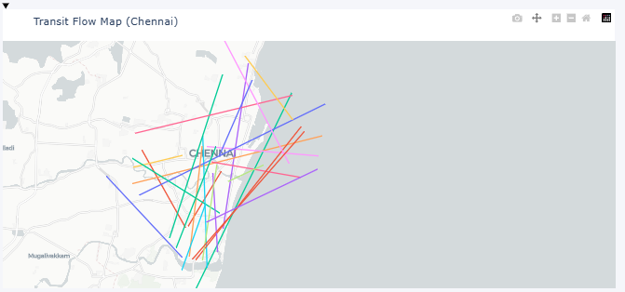
CITY DRILL-DOWN · CHENNAI
Every view, filtered to a single city in one click
The city selector re-runs every callback — maps, KPIs, and charts all narrow to Chennai instantly.
City selector + Mobility Heatmap (Chennai)
Transit Flow Map (Chennai)
SMART URBAN MOBILITY INTELLIGENCE
9

Slide 10
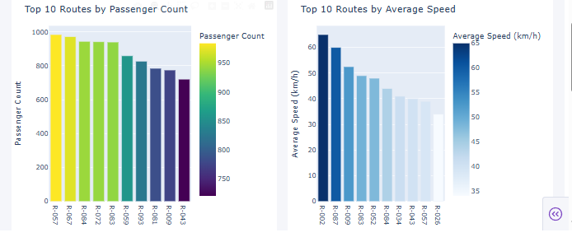
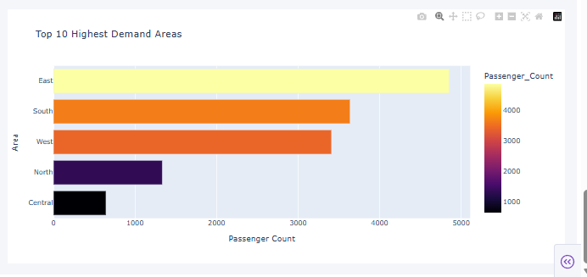
ROUTE PERFORMANCE · CHENNAI
Local performance tells a different story
13,887
25.8 min
34.3 km/h
19.2%
TOTAL PASSENGERS
AVG. TRAVEL TIME
AVG. SPEED
ON-TIME PERFORMANCE
Top 10 Chennai routes — passenger count (left) and speed (right)
Top 10 demand areas — Chennai
SMART URBAN MOBILITY INTELLIGENCE
10

Slide 11
KEY INSIGHTS
What the data tells the planning team
1
On-time performance lags nationally
2
Demand is concentrated, not even
Only 18.4% of trips run on time across India, rising to 19.2% in Chennai — a clear target for schedule optimization.
The East zone consistently leads passenger volume, both nationally and within Chennai, ahead of Central, West and South.
3
City-level speed beats the national average
4
A handful of routes carry outsized load
Chennai's average speed of 34.3 km/h outpaces the 30.9 km/h national figure, despite lower total ridership.
The top 10 routes nationally range from ~4,800 to ~6,300 passengers each — prime candidates for added capacity.
SMART URBAN MOBILITY INTELLIGENCE
11

Slide 12
CONCLUSION & NEXT STEPS
From dashboard to decision support
The current build gives a complete, filterable picture of mobility across 16 cities. The next milestone extends it from monitoring to prediction and action.
1
Predictive delay modeling
Forecast route-level delays using historical traffic, weather and demand patterns.
2
Live data integration
Replace static CSV snapshots with a streaming feed for real-time KPI updates.
3
Route optimization engine
Recommend capacity or schedule changes for the highest-demand, lowest-performing routes.
Thank you
Smart Urban Mobility Intelligence · Python · Pandas · Dash · Plotly

